Slide 1
Title: Cricmetrics IPL 2025
Subtitle: IPL 2025 Data Insights Dashboard
Presented by: Laya Shree G (AF05054173)
Batch code: ANP-D1536
Objective: To analyze player and team performance using Power BI to drive data-driven insights in sports.

Slide 2
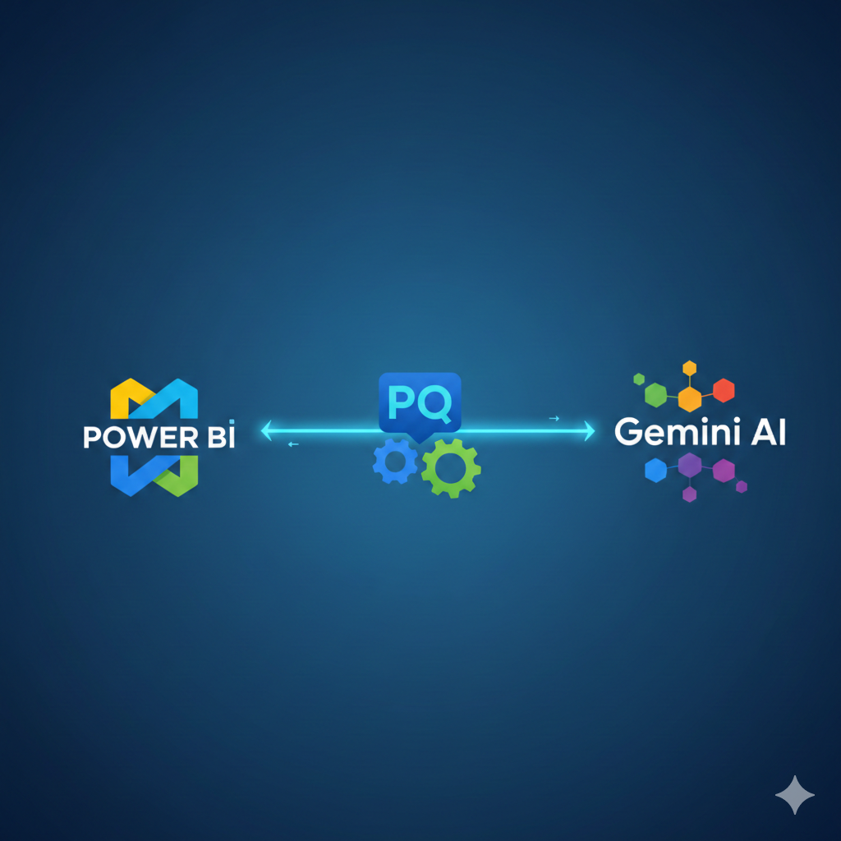
How can we visualize complex cricket statistics to identify top performers?
Tools Used: * Power BI Desktop: For data modeling and visualization.
Power Query: For cleaning the IPL dataset.
DAX (Data Analysis Expressions): For creating custom metrics.
Gemini AI: For concepts understanding.

Slide 3
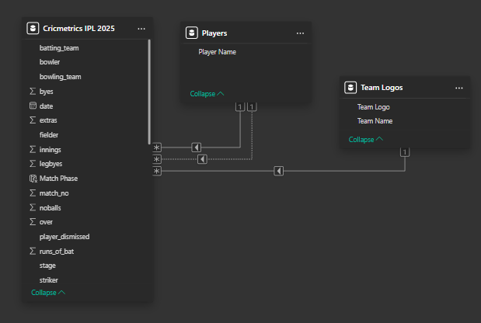
Data Architecture (The "Analyst" Part)
Data Sources: Kaggle Datasets (https://www.kaggle.com/datasets/krishd123/ipl-2025-records)
Data Cleaning:
1. Extraction & Audit
Initial Load: Imported ball-by-ball raw logs for all 74 matches of the 2025 season.
Null Handling: Replaced NaN values with 0 in extras columns (wides, no-balls) to ensure mathematical accuracy.
2. Precision Cleaning
String Trimming: Applied TRIM functions to striker and batting_team columns to eliminate hidden spaces that break DAX filters.
Naming Consistency: Standardized team names (e.g., mapping "RCB" to "Royal Challengers Bangalore") for 100% accurate relationship mapping.
3. Feature Engineering
Metric Creation: Engineered a Total Runs column by aggregating runs_of_bat + extras.
Wicket Logic: Converted wicket_type into a binary Wicket Flag (0/1) to power the Purple Cap leaderboards and Bowling Strike Rate visuals.
4. Structural Optimization
Data Typing: Converted Date from text to Date format and Match_No to Whole Number to ensure chronological sorting and slicer performance.
Model Schema: Established a one-to-many relationship between the TeamLogos table and Deliveries for dynamic image syncing.

Slide 4

Key Performance Indicators (KPIs)
Primary Metrics:
Total Runs: Measuring batting dominance.
Boundary Counts: Analysis of 4s and 6s.
Bowling Impact: Total wickets taken.
IPL 2025 Tournament Score
IPL 2025 Star Players
IPL 2025 Champions (RCB) Score

Slide 5

Visual Features & Branding
Why use this custom images as background?
Performance: It's much faster. One single background image is lighter for Power BI to load than 10 different shapes and text boxes.
Consistency: Your borders, headers, and logos stay perfectly aligned and cannot be accidentally moved while you're editing charts.
Branding: It allows you to use your team’s exact hex colors and high-quality textures that Power BI’s built-in shapes can't replicate.

Slide 6
User Experience & Design Strategy
1. Advanced Interactivity (The Slicer Logic)
Contextual Filtering: I implemented a Match No. Slicer as the primary driver. Selecting a match triggers a "Ripple Effect" across the dashboard, instantly updating the winner’s logo, final score, and player of the match.
Bi-Directional Syncing: Slicers are synced across multiple pages. For example, selecting RCB on the summary page automatically filters the "Player Performance" page to show only RCB athletes, creating a seamless navigation flow.
Cross-Highlighting: Clicking a specific team in the "Total Runs" bar chart cross-filters other visuals (like the venue performance), allowing users to see where a team was most dominant.
2. Strategic Design Choices (The "Cricmetrics" Feel)
Iconography over Text: Instead of simple tables, we used Team Logos and Player Images. This "Card-First" design approach mimics professional sports apps (like ESPN or Cricbuzz), making the data immediately recognizable.
The "Worm Chart" (Line Chart): I chose this specific visual for innings progression because it effectively communicates the "swing" in momentum—showing exactly where a match was won or lost in the death overs.
Color Palette: I used a high-contrast dark theme with team-specific neon accents. This reduces eye strain and makes the data points "pop" against the custom stadium background.

Slide 7
Key Insights (The "Business" Part)
1. The Individual Dominance (Orange & Purple Caps The data highlights that while one player can lead the charts, they need team support to win the trophy. =>Sai Sudharsan (759 Runs): His data shows incredible consistency, likely anchoring the Gujarat Titans' innings. The high volume of runs suggests a high "Balls Faced" count, making him the tournament's most valuable anchor. =>Prasidh (25 Wickets): Leading the Purple Cap race indicates he was highly effective in the Powerplay or Death Overs—the two phases where wickets are hardest to get but most impactful.
2. The Winning Formula: RCB's Path The data confirms why RCB emerged as the Tournament Winner: => Death Over Efficiency: If you look at your "Runs by Over" chart, RCB likely shows a spike in the last 5 overs. Winning the final match (Match 74) usually comes down to who handled the pressure of the final 30 balls. =>Boundary Percentage: The "Total Sixes" and "Fours" visuals likely show that the top 3 teams (RCB, SRH, KKR) relied heavily on boundary hitting rather than just strike rotation.
3. Venue & Match Dynamics =>Toss vs. Result: By using your slicers, the data might show that teams chasing had a slight advantage in the 2025 season, or perhaps specific venues (like the final match venue) favored the team batting first. =>The "Momentum" Shift: Your Worm Chart (Line Chart) for each match tells us that most games were decided between Overs 12 and 16. A dip in the "Worm" usually correlates with a cluster of wickets that slowed down the run rate.

Slide 8
Key Learning Outcomes
DAX Proficiency: Moved beyond basic sums to complex logic, including variables (VAR/RETURN) and filter context manipulation.
UI/UX Design: Learned that a dashboard must be "intuitive." Using custom stadium backgrounds and team icons improved user engagement compared to standard tables.
End-to-End Analyst Workflow: Gained experience in the full lifecycle of a project—from raw CSV cleaning to delivering a "Boardroom-ready" presentation.

Slide 9
The Value of Cricmetrics 2025
Actionable Insights: This dashboard transforms 15,000+ rows of raw ball-by-ball data into clear insights, identifying that RCB’s victory was driven by specific high-pressure performance metrics.
Scalability: The architecture is built to be "future-proof." By simply swapping the CSV file, this dashboard can analyze any future IPL season or domestic league.
Decision Support: It demonstrates how sports franchises can use data to evaluate player consistency (like Sai Sudharsan) and bowling impact (like Prasidh) for better auction strategies.

